Slide 1
Graph-Based Multimodal Fusion for Dementia Subtype Classification
An Architectural Comparison
Abraham Furlan, Daniel Noone, Jacob Mongold

Slide 2
Motivation
Clinical Motivation:
Differential diagnosis between Alzheimer's, vascular dementia, Lewy body, and frontotemporal dementia is difficult in practice because these conditions share cognitive symptoms but differ in underlying pathology and brain structure.
Mild Cognitive Impairment (MCI) patients represent a clinically ambiguous population, or early accurate risk stratification could change care trajectories.
Other Motivations:
Dementia diagnosis naturally involves multimodal evidence like:
Structural MRI
Cognitive assessments
Vascular risk
Genetics
Medical history
But most models use these modalities in isolation or fuse them too late in the pipeline.
Late fusion approaches miss early interactions between imaging and clinical features that may be diagnostically important.
Notes:
Jacob

Slide 3
Related works:
Multimodal Fusion:
Pölsterl et al. — Combining 3D image and tabular data via the dynamic affine feature map transform
Xue et al. — AI-based differential diagnosis of dementia etiologies on multimodal data
Hypergraph Methods:
Ding et al. — Hypergraph convolutional network for longitudinal data analysis in Alzheimer's disease
Yang et al. (2022) — An evolving hypergraph convolutional network for the diagnosis of Alzheimer's disease
Neurological Diseases:
Cao et al. — Dementia classification using a graph neural network on imaging of effective brain connectivity
Zheng et al. — CI-GNN: A Granger causality-inspired graph neural network for interpretable brain network-based psychiatric diagnosis
Population Graphs for Patient Modeling:
GNNs used to model patients as nodes
Improves diagnosis by incorporating clinical similarities
Key: modeling relationships between patients improves diagnostic performance [1,2,3,4,5]
Hypergraphs for Higher-Order Relationships
Hypergraphs connect groups of patients, shared patterns
Improve modeling of overlapping disease classes
Many approaches use static, pre-defined hyperedges
Key: Hypergraphs shown to help capture richer relationships between patients [6,7,8]
Multi-Modal Fusion for Neurological Diagnoses
MRI and clinical data provide complementary signals
Fusing these together with methods like DAFT, Hypernetworks, and Cross-attention shown to improve diagnostic accuracy [9,10,11]
[1] Kipf & Welling, 2017
[2] Zhou et al.,2023
[3] Lin et al., 2023
[4] Kazemia et al., 2024
[5] Yang et al., 2024
[6] Ding et al., 2023
[7] Yang et al., 2022
[8] Liu et al., 2025
[9] Pölsterl et al., 2021
[10] Duenias et al., 2024
[11] Xue et al., 2024
[1] Kipf & Welling, 2017
[2] Zhou et al.,2023
[3] Lin et al., 2023
[4] Kazemia et al., 2024
[5] Yang et al., 2024
[6] Ding et al., 2023
[7] Yang et al., 2022
[8] Liu et al., 2025
[9] Pölsterl et al., 2021
[10] Duenias et al., 2024
[11] Xue et al., 2024
Notes:
DAN:

Slide 4
Preprocessing: National Alzheimer's Coordinating Center (NACC) Data
Tabular Clinical Data preprocessing:
Patient Selection: Sort through the tabular data to select a cohort of patients equally distributed among the 6 Neurodegenerative classes (200-300 patients out of 52,000).
Feature Selection: Find and extract 32 unique tabular features for each patient in the dataset.
Normalize: Scale and Normalize each feature in the dataset so no one feature overpowers the others.
MRI Image preprocessing:
Scan selection: Get the best T1-weighted scan for each selected patient in the cohort.
Spatial standardization: Force every scan into the exact same anatomical orientation and scale.
Cropping to fixed size: Remove background and pad as needed. Center crop to 96x96x96 voxels.
Intensity normalization: Rescale to [0, 1] for cross-scanner comparability.
Notes:
Abe

Slide 5
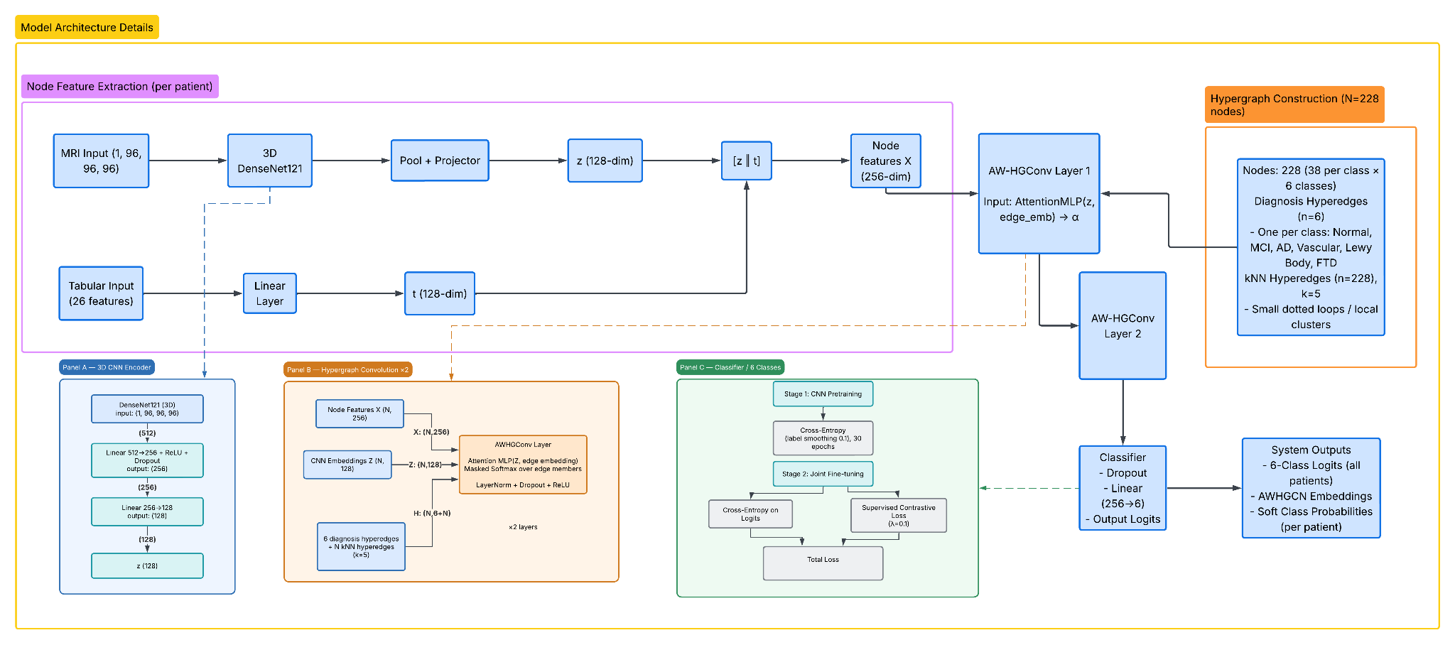
Architecture: Attention-Weighted Hypergraph Convolutional Network (AWHGCN) (Mongold)
Notes:
Per-patient encoder (Node Feature Extraction):
MRI → 3D DenseNet121
Tabular
Hypergraph construction (across all N nodes):
6 diagnosis hyperedges — one per class, train nodes only (prevents leakage)
N kNN hyperedges (k=5) over tabular feature space — capture local similarity
Attention-Weighted Hypergraph Conv (×2 layers):
Attention MLP scores each (node, hyperedge) pair using z + edge embedding → α
Masked softmax over edge members → weighted incidence B_w = H ⊙ α
Propagate: X′ = D_v⁻¹ · (B⊙α)(B⊙α)ᵀ · X · W → LayerNorm + Dropout + ReLU
Attention is computed from z (image content), keeping it tied to imaging signal
Classifier head:
Dropout → Linear(256→6) → 6-class logits
System outputs:
6-class classification logits
AWHGCN node embeddings for UMAP visualization
Soft probability scores per class
Two-stage training:
Stage 1: CNN pretraining with Cross-Entropy (label smoothing 0.1), 30 epochs
Stage 2: Joint fine-tuning, loss = CE + 0.1 × Supervised Contrastive (pulls same-class embeddings together)

Slide 6
To Next Layer
Spatial Features
Feature
Modulation
MRI Image
Data
3D CNN
Raw Patches
Blended Patches
Classification
Head
Message Passing
Tabular
Clinical
Data
Hyperedge Construction
Adjacency Matrix
The same Adjacency Matrix is used for every layer
Architecture: Hyperfuse (Furlan)
Notes:
Abe

Slide 7
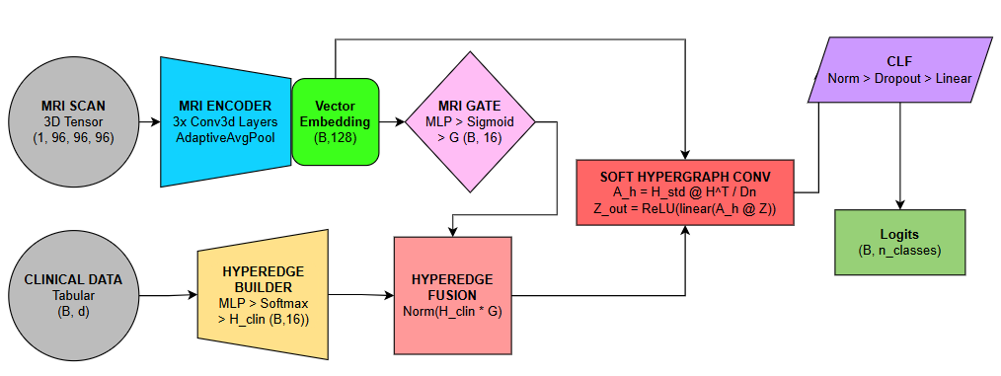
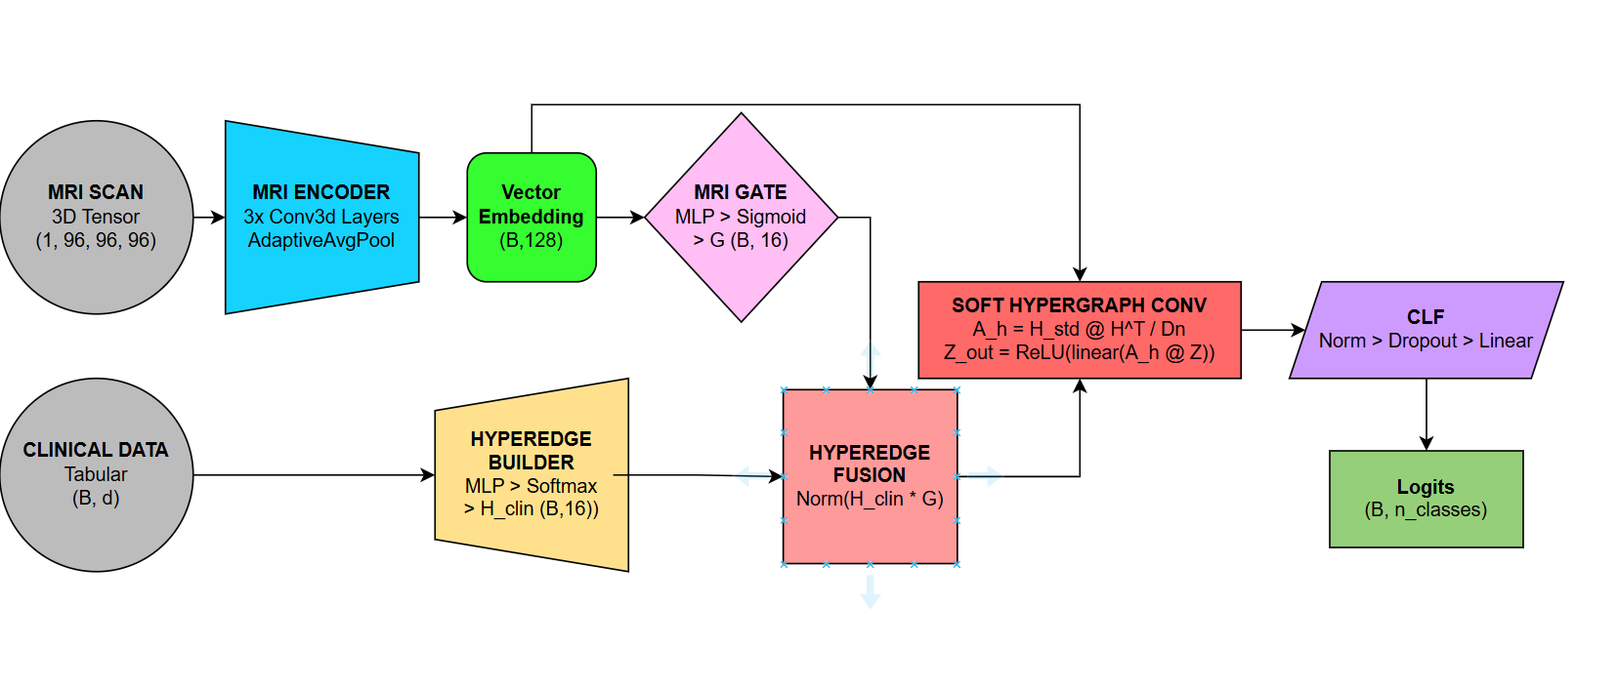
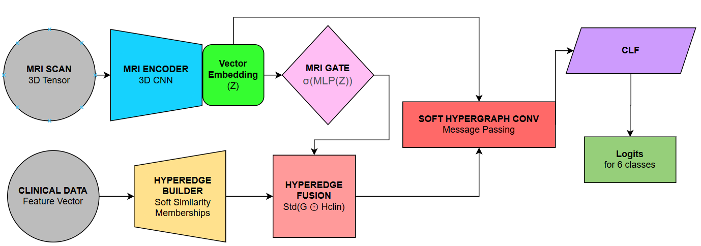
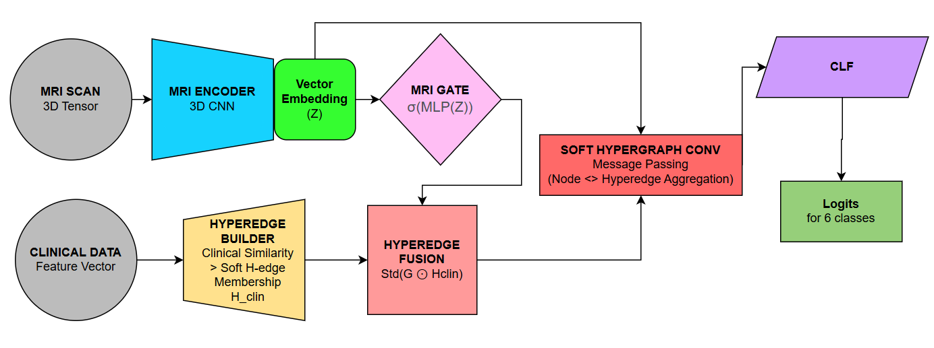
Architecture: Gated Cross-Modal Hypergraph Network (GCMHN) (Noone)
Notes:
> My model is a Gated Cross-Modal Hypergraph Network →
> Goal is to use clinical tab data to PROPOSE Px relationships → THEN use mri features to REFINE them
MRI ENCODER → pased through small 3D CNN encoder → to 128 dim embedding → each px is node represented by struct brain feats
CLINICAL HYPEREDGE BUILDER → clinical tab features passed thru MLP → produces soft hyperedge memberships → each Px belongs partially to multiple subgroups instead of forced into one
MRI GATING MECHANISM → key part… MRI embedding produces a gate between 0 and 1 for each hyper edge. ⇒ ⇒ clinical data suggests these relationships,, MRI decides how much to keep or suppres relationships
CLINICAL DATA = propose groupings of Px, MRI DATA validates/weakens them
REFINED HYPERGRAPH → after gating → renormalize hyperedge memberships → then each Px memberships still sum properly to 1 → GIVES FULL HGRAPH STRUCTURE USED FOR MESSAGE PASSING
HYPERGRAPH MESSAGE PASSING → graph convl builds a pt to pt propagation mx from shared hyperedge memberships → Pxs w similar gated clinical-mri profiles exchange info and model learns which Hedges are more important -
FINALLY → CLASSIFIER → goes through layer norm, dropour, linear clf to produce logits for six disease classes
WHY GATING? ⇒ two Pxs can look similar clinically but have diffeent structural MRI patterns → GATE LETS IMAGING FEATYRES CORRECT OR REFINE RELATIONSHIP STR FROM CLINICAL DATA

Slide 8
Results
Model | Data | Accuracy | Macro-F1
CNN | 3D MRI Images | 0.670 | 0.659
XGBoost | Tabular Clinical Data | 0.650 | 0.624
AWHGCN | Both | 0.29 | 0.23
Hyperfuse | Both | 0.348 | 0.312
GCMHN | Both | 0.20 | 0.13
Notes:
DAN
> Can see a results table here of the baseline and our model performances
> Baseline: CNN trained on only 3D MRI images, XGBOOST trained on only tabular clinical data.
> Can be seen that each of our models underperformed in relation to baselines, with the HYPERFUSE model getting the best macro-f1
> Likely reasons:
> Had a very small dataset → multi modal and graph structure learning models like ours require more training data
> Full dataset was around 1.7 TB so not feasible for this project → only used a small subset around 20-30 GB (~ 200 Px)

Slide 9
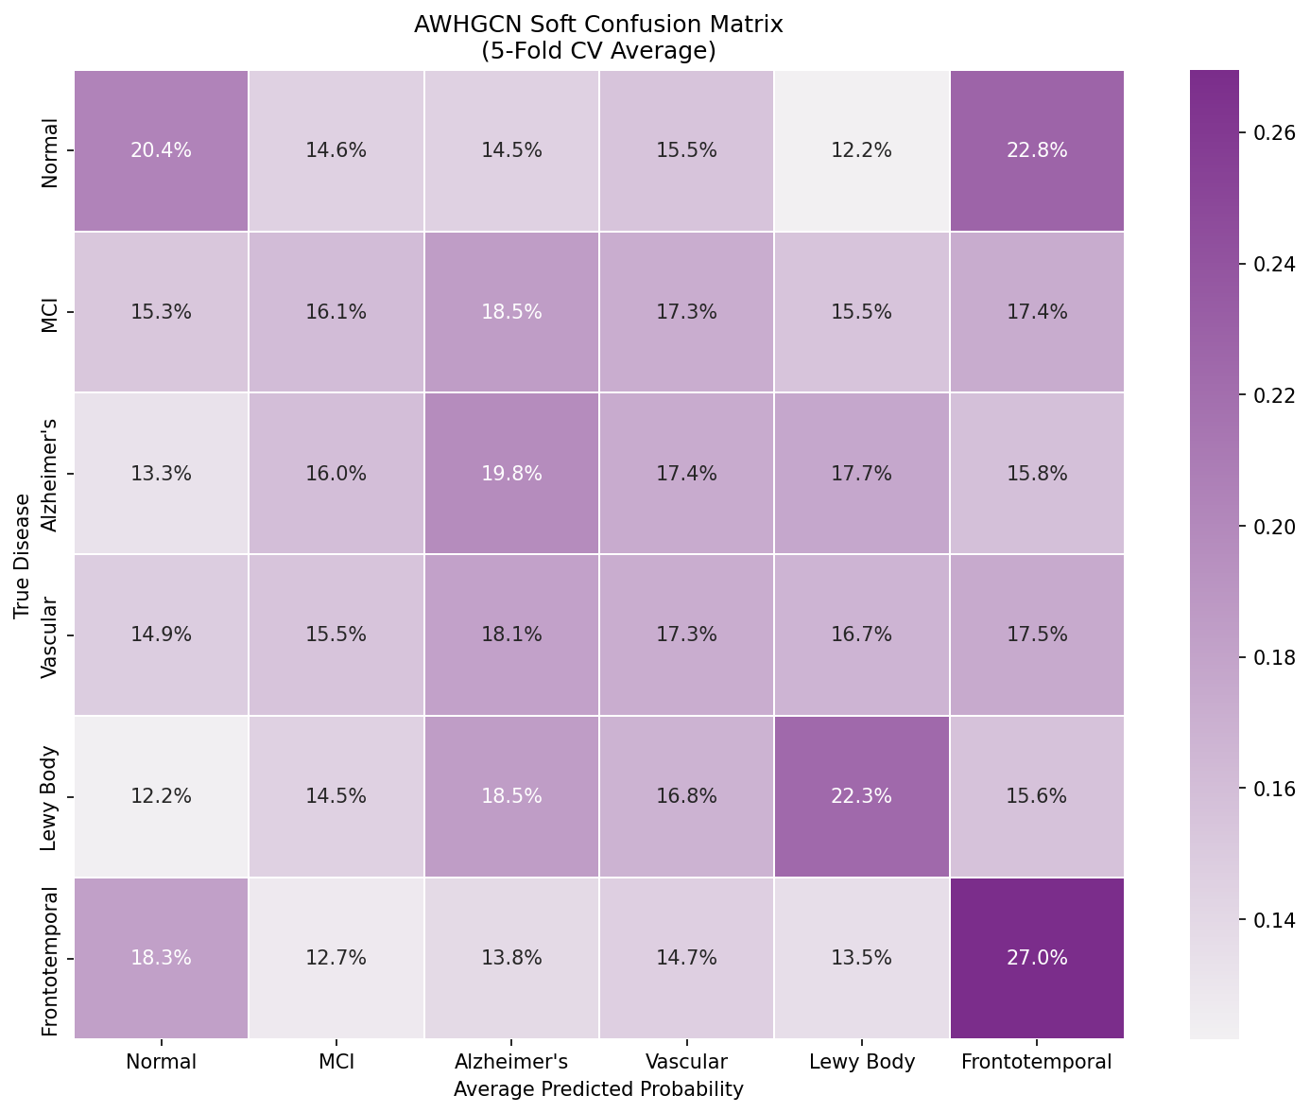
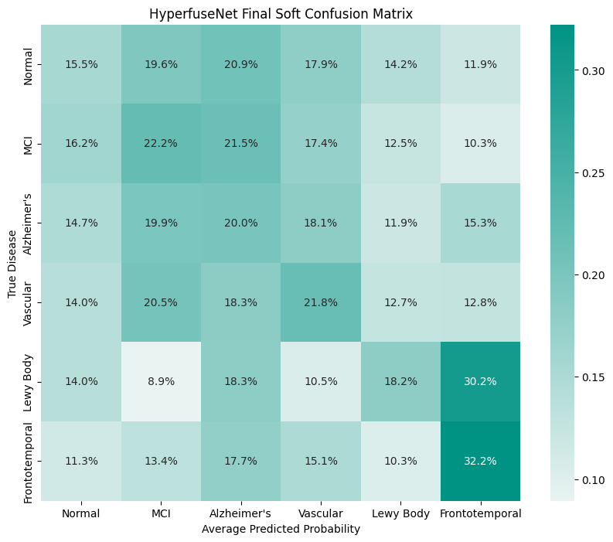
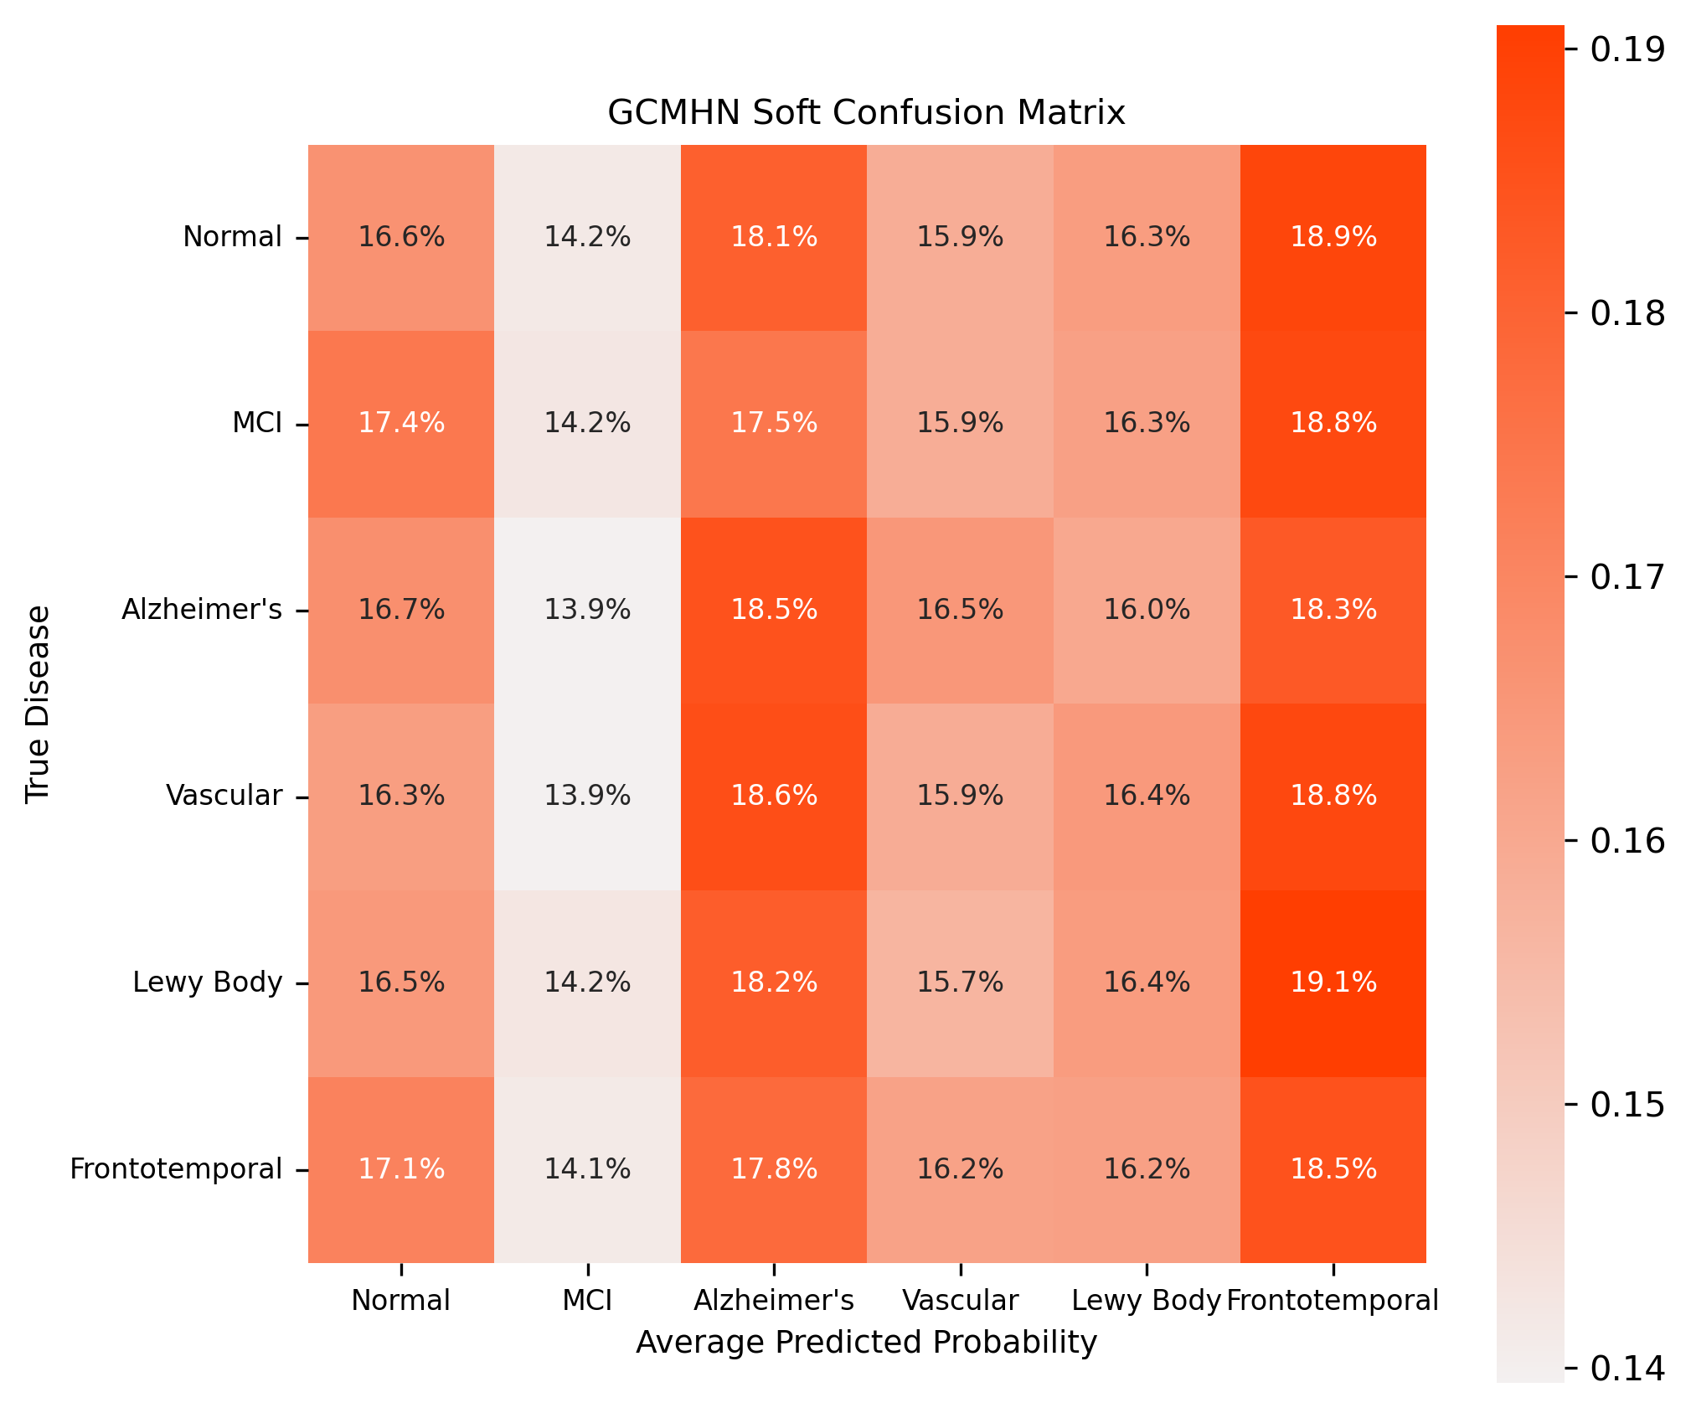
Results - Heatmaps
AWHGCN
Hyperfuse
GCMHN
Notes:
Abe

Slide 10
Conclusion
Hypergraph fusion underperformed unimodal baselines. All three architectures fell well below the stand-alone CNN (0.67) and XGBoost (0.65). The soft confusion matrices show us the predictions diffuse across classes instead of concentrating on the diagonal.
Takeaways:
Training on a very small fraction of data made it so that each model was overly architected and prone to model collapse.
Strong per-modality encoders matter more than the fusion layer.
By using aggressive subsampling (228 out of 52 thousand), traded class balance for statistical power. The models couldn't learn six-way discriminative boundaries from that little data, regardless of architecture.
Notes:
Jacob

Slide 11
Thanks for Listening!

